Slide 1

Introduction to
Machine Learning
IUT AI Student Chapter

Slide 2

Applications
Pinterest – Improved Content Discovery
Notes:
https://www.wordstream.com/blog/ws/2017/07/28/machine-learning-applications

Slide 3
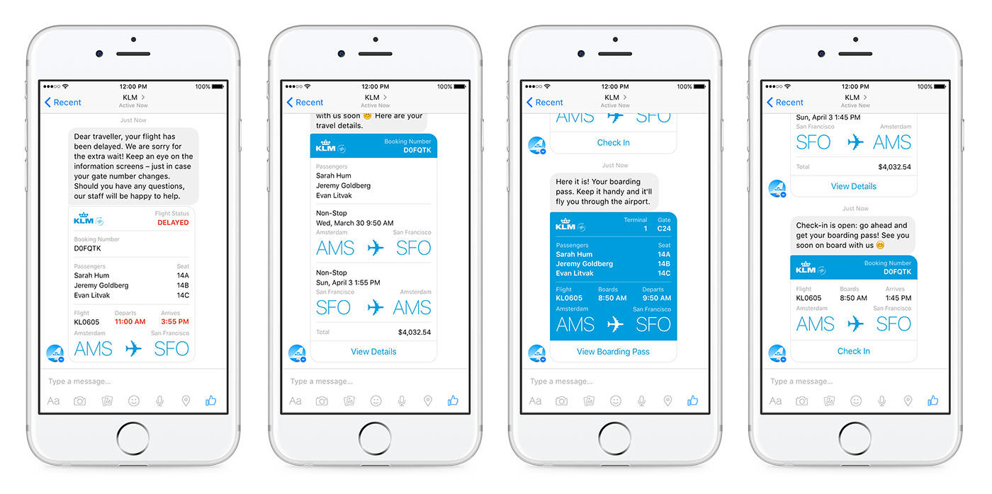
Applications (Cont.)
Facebook – Chatbot Army

Slide 4
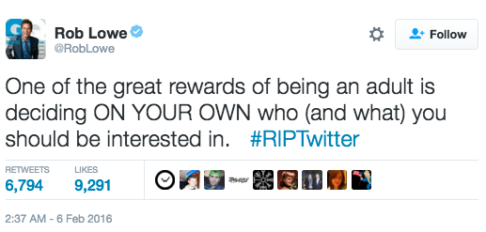
Applications (Cont.)
Twitter – Curated Timelines

Slide 5
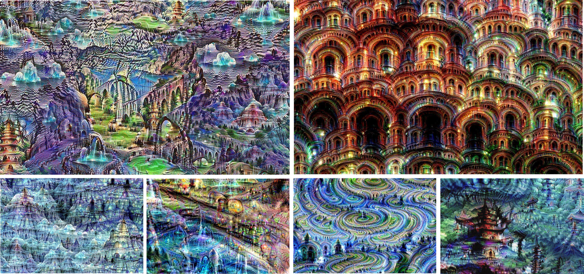
Applications (Cont.)
Google – Neural Networks and ‘Machines That Dream’

Slide 6
Machine Learning is a subfield of computer science that gives “computers the ability to learn without being explicitly programmed.”

Slide 7
A more modern definition:
A computer program is said to learn from experience E with respect to some class of tasks T and performance measure P, if its performance at tasks in T, as measured by P, improves with experience E.

Slide 8
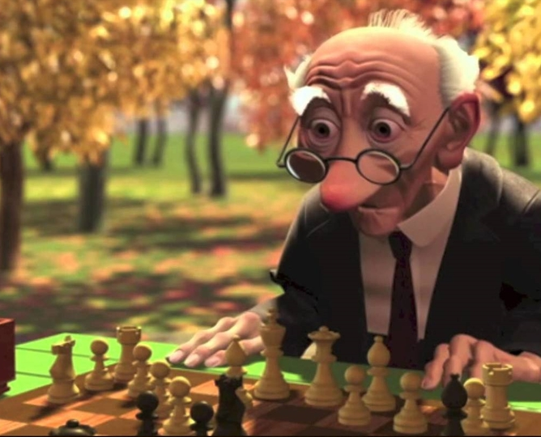
Playing Chess
E = the experience of playing many games of chess
T = the task of playing chess.
P = the probability that the program will win the next game.

Slide 9
Machine Learning
Training Data
Machine Learning Algorithm
Training Phase
Prediction Phase
Data
Learned Model
Prediction

Slide 10
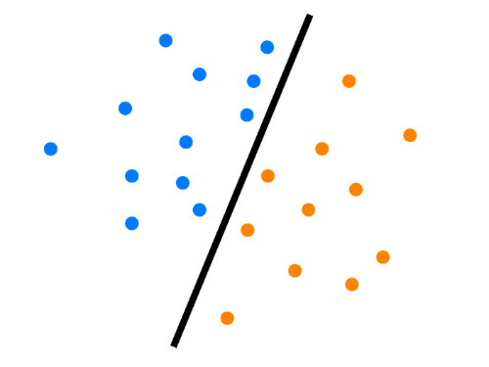
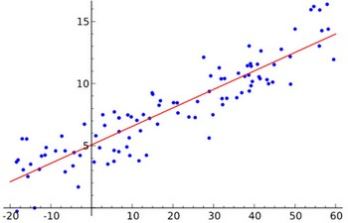
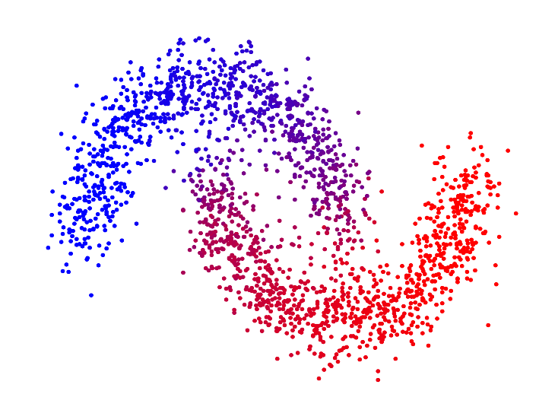
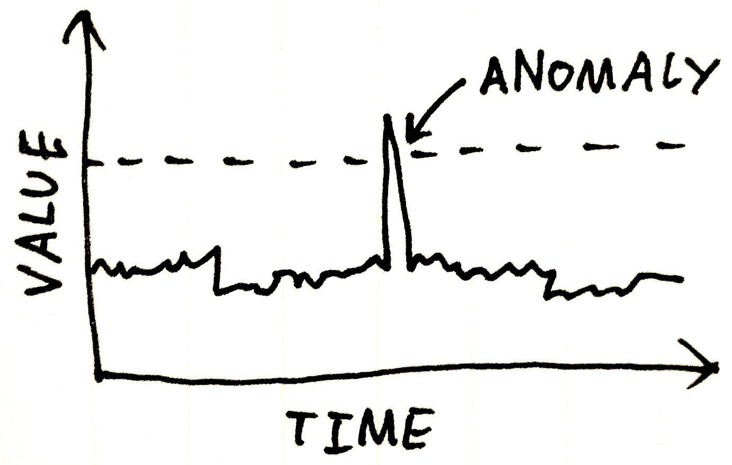
Many Problems
Classification
Supervised
Regression
Supervised
Clustering
Unsupervised
Anomaly Detection
Unsupervised

Slide 11


Slide 12
Supervised Learning
Linear Regression
IUT AI Student Chapter

Slide 13



Pricing Houses
70000 $
210000 $
?

Slide 14
25
20
15
13
10
5

Slide 15
Supervised Learning
Classification
IUT AI Student Chapter

Slide 16

Mail Spam/not Spam Example

Slide 17
Detecting Spam Email
Spam
Non-Spam

Slide 18

Detecting Spam Email
“cheap”
Spam
Non-Spam

Slide 19
Detecting Spam Email
Spam
Non-Spam
IF an email contain the word “cheap” , what is the probability of it being spam?
“cheap”
conclusion:
If an email contain the word “cheap” The probability of it being spam is 80 %
5
20
20%
80%

Slide 20
Unupervised Learning
IUT AI Student Chapter

Slide 21
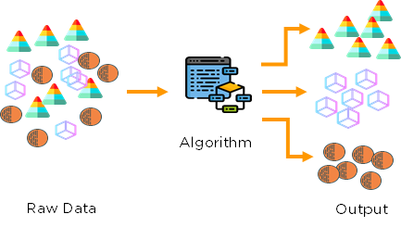
Clustering

Slide 22
Linear Regression
IUT AI Student Chapter

Slide 23
Regression
How can we predict the grade of a student?
We need to know the features
Also the outcome

Slide 24
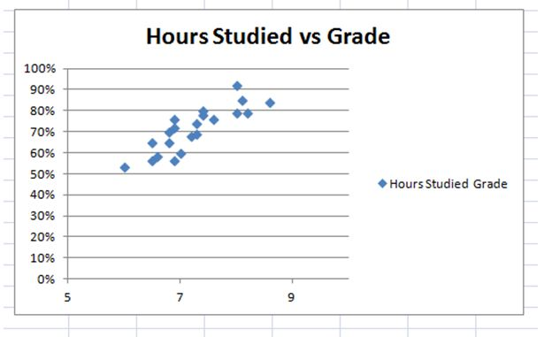
Grade prediction

Slide 25
Jargon
IQ, hours studied, … are Features
Grade is called Label
The dataset is called training set
Features : ‘x’
Labels : ‘y’
Predictions : ‘ŷ’

Slide 26
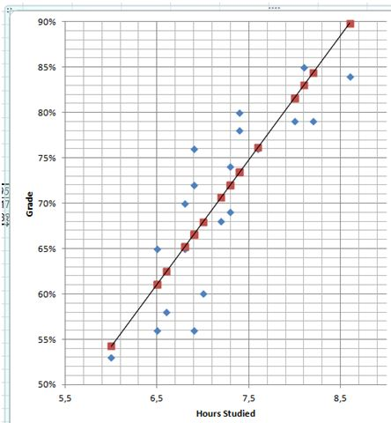
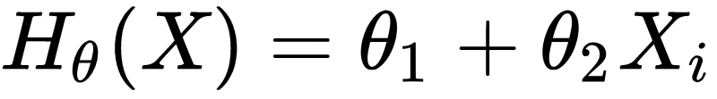
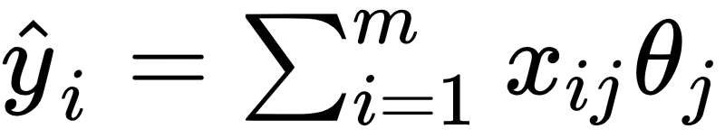
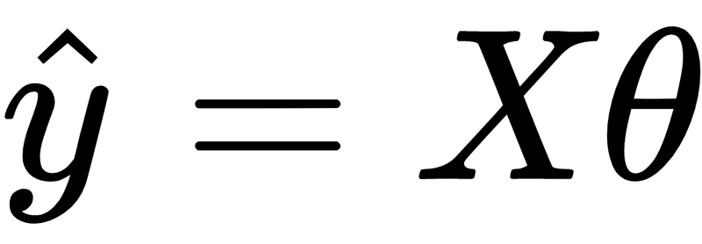
Hypothesis
Prediction :
But how to find the best parameters?

Slide 27
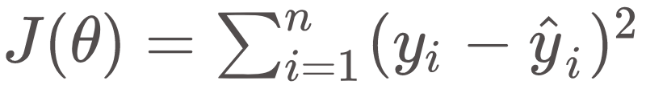
Loss Function
a.k.a Loss, Objective, Error, Cost, Energy
Mean squared error

Slide 28
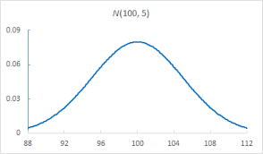
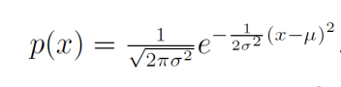
Where it comes from?
P(X=x) : Probability Distribution
Let’s work with the Gaussian

Slide 29
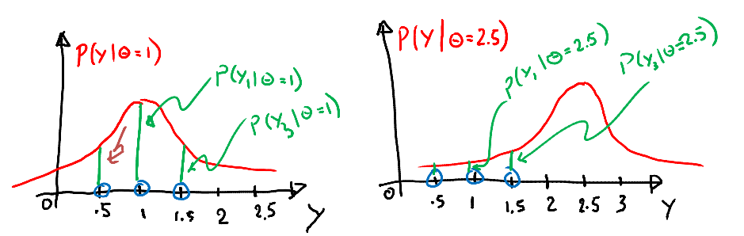
likelihood
Consider we have three data points y= 1 , 0.5, 1.5 and known variance of 1
Let’s guess Theta = 1 or Theta = 2.5?

Slide 30
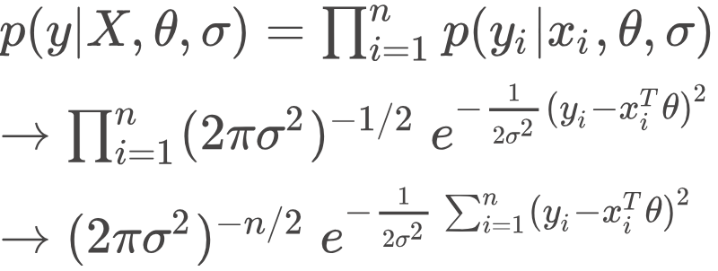
likelihood
Objective = to maximize the likelihood
What if we take negative of logarithm?

Slide 31
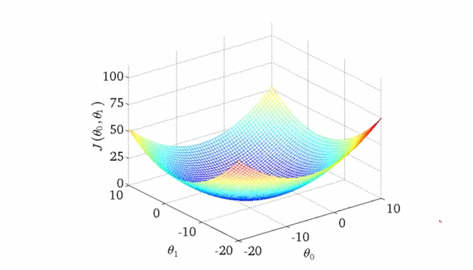
Optimization
Goal: Minimize J(θ)
Finding the exact answer can be infeasible when number of parameters increase

Slide 32
Gradient Descent
Start with some initial value for Thetas
Keep changing them to reduce J(θ)
Take steps proportional to the negative of the gradient

Slide 33
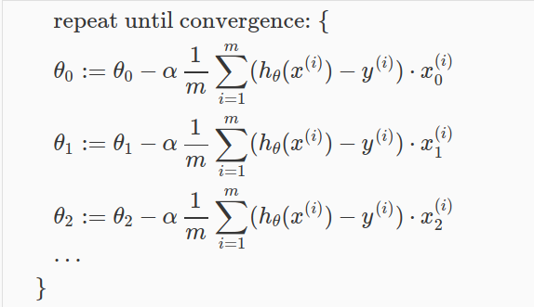
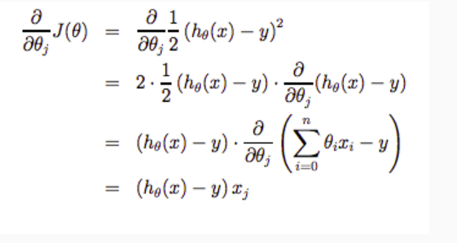
Gradient Descent

Slide 34

GD visualization

Slide 35
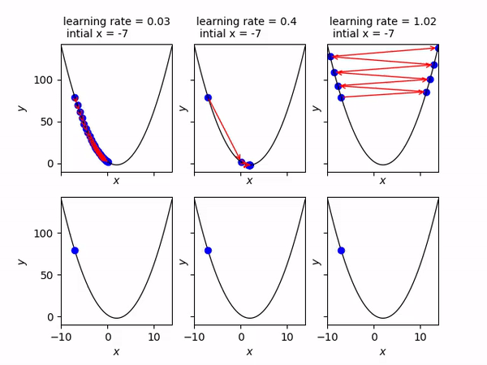
What was 𝝰?
Learning rate : how big the steps are.
(changing mind more quickly! )

Slide 36
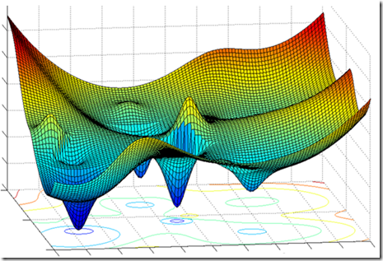
When it fails?

Slide 37
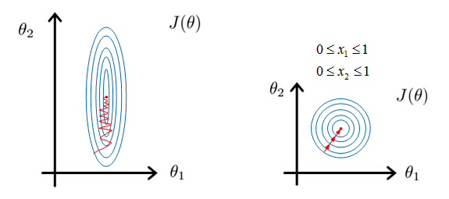
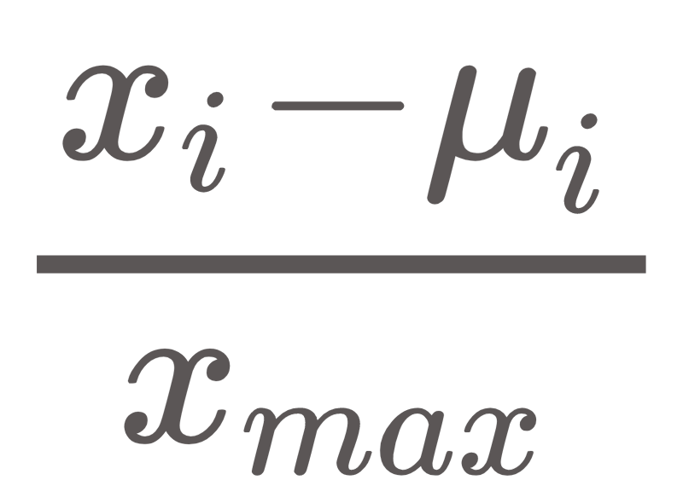
Feature scaling
Consider we have:
X1 = price [0, 20000000]
X2 = RAM [8, 16]
Normalization: Divide each feature by max of the feature column.
Mean Normalization:

